Slide 1
Predicting Project Success
Part 2: Research Questions
CS109B Final Project April 2020
Yael Grushka-Cockayne
Twitter: @grushkay
email: ygc@hbs.edu

Slide 2
Takeaways Part I

Slide 3
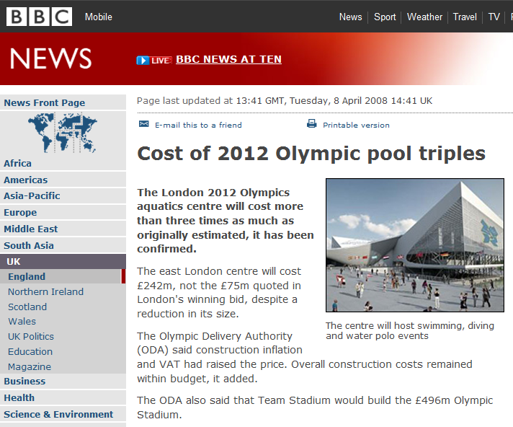
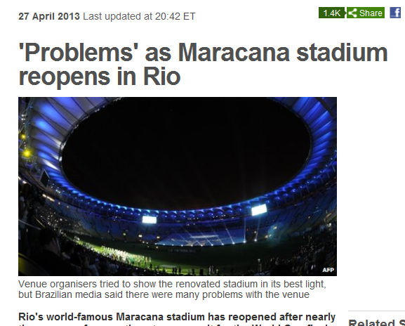
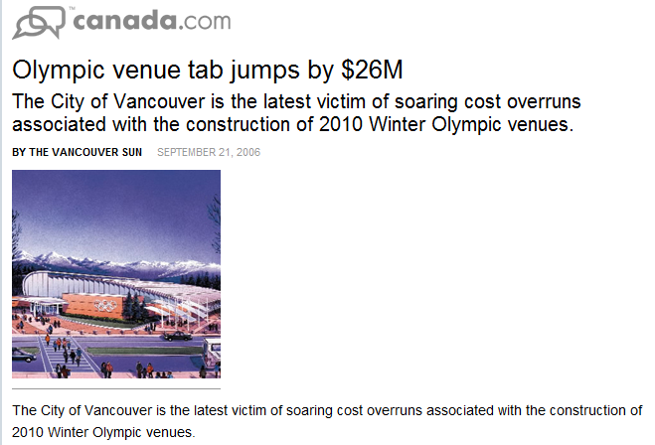
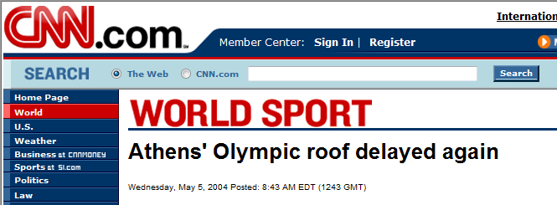
Lets talk about project performance…

Slide 4
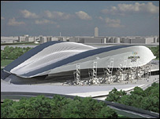

The Planning Fallacy
The tendency to underestimate task-completion times and costs.
Projects routinely cost more, take longer, and deliver less than expected.
Individuals, and firms, overpromise and under-deliver
3 times the cost
Two years late
1/3 the size

Slide 5
The Project Management Paradox
Modern Project Management tools are extremely sophisticated (e.g. Critical path analysis, Monte Carlo Simulation)
Still
Individuals, public and private firms routinely suffer from the planning fallacy
                But why?

Slide 6
Why is project performance important?
The GDP contributions from project-oriented industries are forecasted to reach $20.2 trillion.
9.9% of every dollar is wasted due to poor project performance— that’s $99 million for every $1 billion invested!
Around $100k is wasted every 20 seconds—or $2 trillion every year, from global capital investment.
PMI, 2018 Pulse of the Profession study

Slide 7
Why Do Projects Fail?

Slide 9
Completing Three Tasks
A
B
C
10
10
10

Slide 10
Completing Three Tasks
A
B
C
10
10
10
A
B
C
A
B
C

Slide 11
Completing Three Tasks
A
B
C
10
10
10
A
B
C
A
B
C
20
20
20

Slide 12
Why Do Plans Fail?
  Overconfidence/Optimism
  Parkinson's Law: "work expands so as to fill the time available for its completion"
  Interdependencies
  Student Syndrome
  Merge Bias/Lateness Passed Down the Schedule
  Multi-tasking
  Anchoring

Slide 13
Can We Overcome?

Slide 14
Can We Overcome?
  Data and Outside View
  Project level buffers
  Small dedicated teams
  Specific and short tasks
  Team work
  Wisdom of the Crowd

Slide 15
Inside vs. Outside view
Inside View:
  Describing the future as a narrative.
  E.g. CPM: Developing a series of steps that leads from beginning to end of a project.
  How long will each task take?
  What resources will be needed?
Outside View:
  Taking a statistical perspective.
  Ignores the detail of the case at hand.
  Estimating task duration/cost/benefits by asking about previous, similar tasks.
  Reference class forecasting
Kahneman and Tversky, 1979

Slide 16
Outside view / Reference class Forecasting
  Select a reference class – previous projects similar on important characteristics
  From the reference class, assess the distribution of outcomes
  Identify where your project falls in the distribution
  Assess the reliability of your predictions
  Adjust estimate toward average based on estimate of reliability
Lovallo and Kahneman, HBR 2003

Slide 17
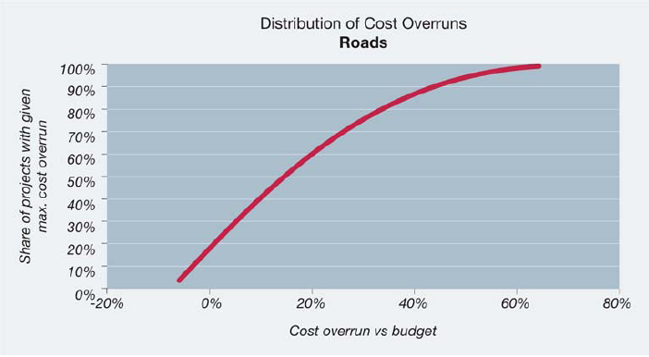
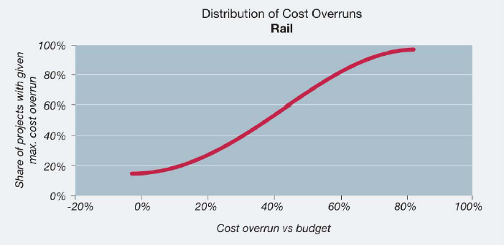
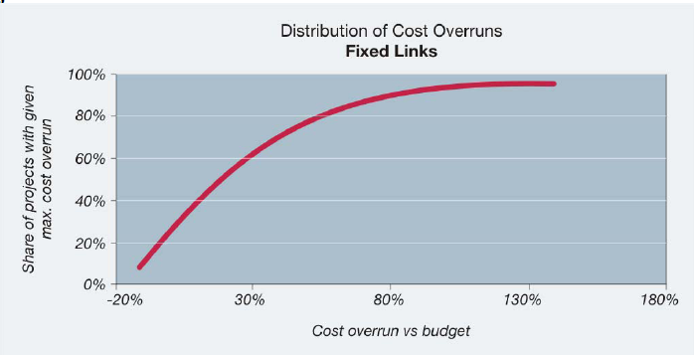
Countering the Planning Fallacy

Slide 18
Implementations
Implementations of Reference class Forecasting and the Outside View:
  The British Department for Transport and Network Rail
  American Planner’s Association
  The Association of the advancement of Cost Engineering
Implementations of Wisdom of the Crowd
  Prediction Markets at Google, HP, Ford, etc.
  Planning Poker

Slide 19
NYC DPR Observations
  NYC DPR exhibits strong planning fallacy.
  Project attributes which lead to faulty parameter estimation when the fallacy does occur:
    Size ($)
    Type of project
    Construction unit
  New features can be introduced: e.g. experience of team (using frequency in dataset).

Slide 20
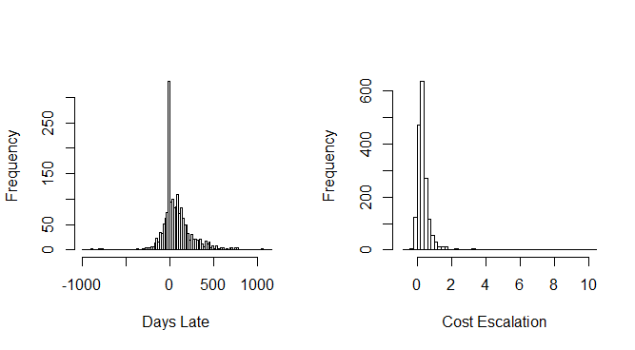
Yes! Planning Fallacy Does Exist
Cost
Under budget | 131 | 7%
Over budget | 1659 | 93%
 | Mean | Standard Deviation | Median
Late (Days) | 78.2 | 190.64 | 44
Cost Escalation (%) | 44% | 1.13 | 30%
Late
Early | 576 | 32%
On time | 113 | 6%
Late | 1101 | 62%

Slide 21
Identifying Reference Class
Team | Average days late
Architecture | 729.0
Construction Resources | 303.0
Staten Island Team | 205.0
Manhattan Team | 139.6
Brooklyn Team | 131.1
Team | Average cost escalation
Technical Services (Randalls Isl.) | 70%
Manhattan Team | 67%
Environmental Control Unit | 66%
Queens Team | 60%
Bronx Team | 46%

Slide 22
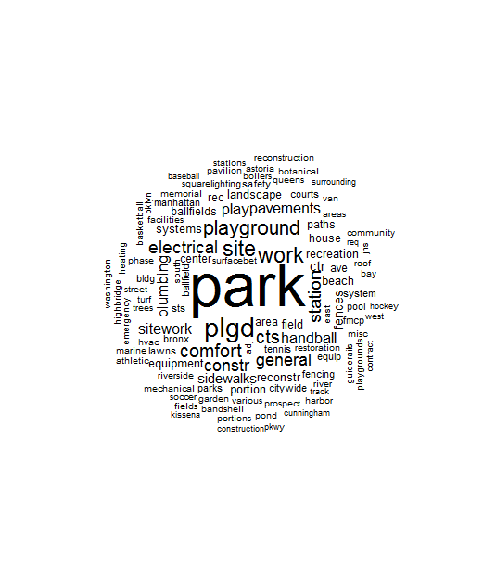
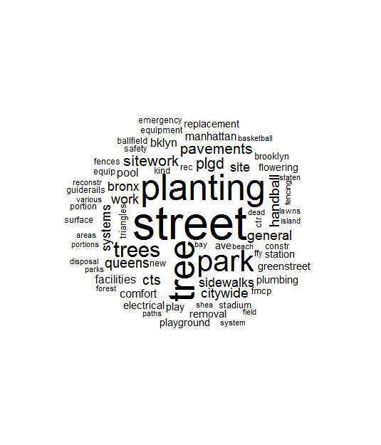
Using Text Analysis to Identify a Reference Class
Not Late
Late

Slide 23
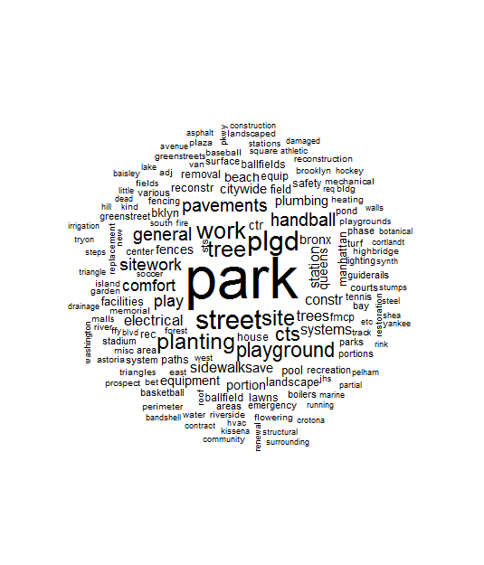
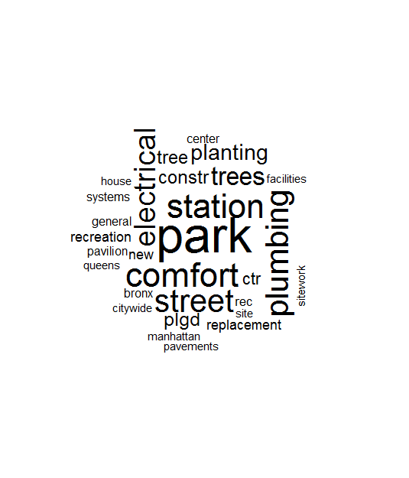
Using Text Analysis to Identify a Reference Class
Not Over budget
Over budget

Slide 24
Identifying Reference Class
 | Electrical | Tree | Landscape | Plumbing | Park | Station | Playgrd
Count | 106 | 270 | 58 | 91 | 570 | 118 | 354
Average cost escalation | 62% | 20% | 49% | 10% | 53% | 74% | 37%
Average duration overrun | 172.2 | -45.6 | 138.7 | 178 | 115 | 138 | 95.5

Slide 25
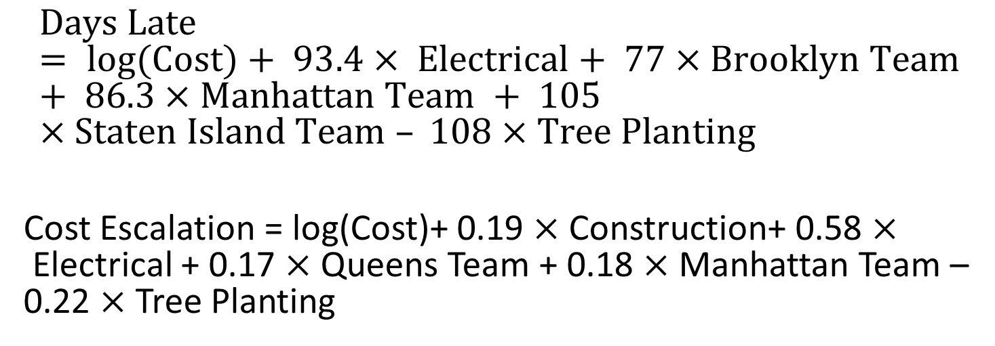
Prediction Models: Regression Models
$$Days Late = log(Cost)+ 93.4× Electrical+ 77×Brooklyn Team + 86.3×Manhattan Team + 105×Staten Island Team – 108×Tree Planting$$
Cost Escalation = log(Cost)+ 0.19 $×$Construction+ 0.58 $×$Electrical + 0.17 $×$ Queens Team + 0.18 $×$Manhattan Team – 0.22 $×$ Tree Planting

Slide 26

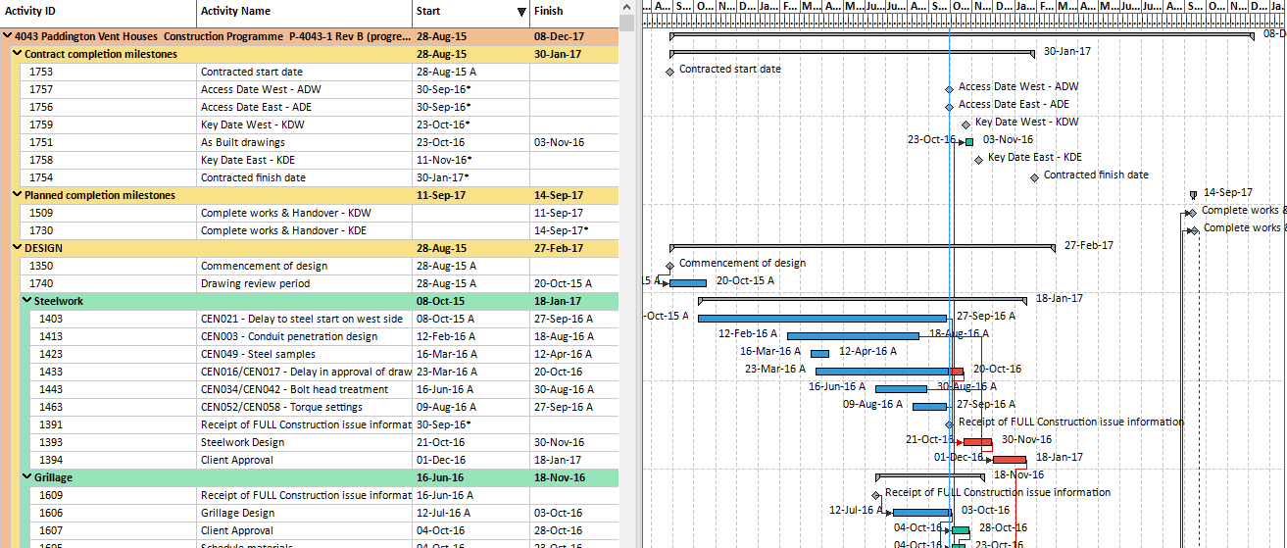
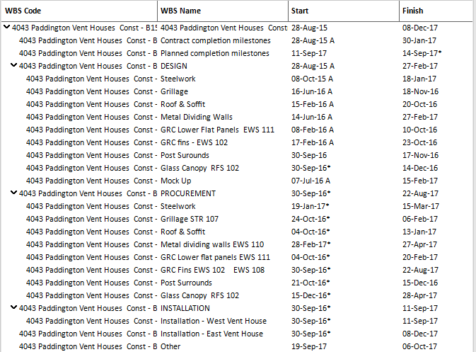
  Using historical data and machine learning to predict tasks that are delayed
  Predict task delays by using text information and learning the structure of the project around the task.
  Over 250,000 construction project plans and actual timelines

Slide 27

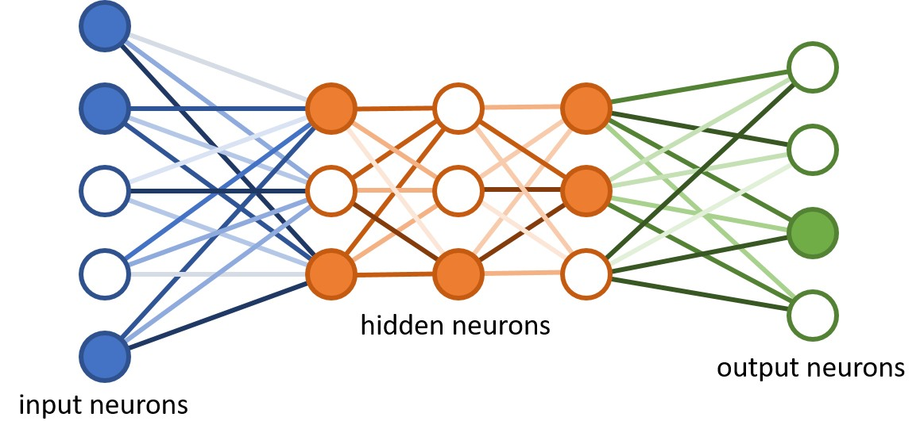
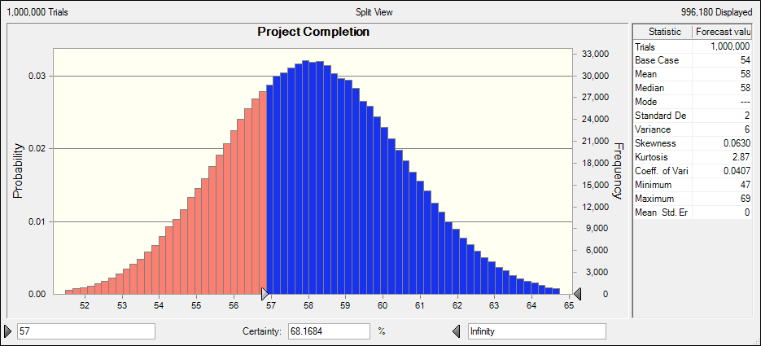
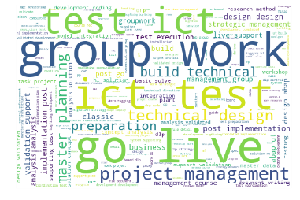
A Vision for a Data-Driven Planning Process
A database of completed projects
NLP generates numerical representations of tasks
  Predict project delays
Predict task delays
  Identify main sources of risk
Determine key factors that impact delays
A project planning text corpus

Slide 28
Features
Task names
Relative position (time since the project’s start / total duration of the project)
Number of predecessors
Number of successors
Planned duration
Number of parallel tasks
Predicting: $\text{task} \text{delay}=\frac{actual duration}{planned duration}$

Slide 29
Data
Construction project schedules provided by nPlan
72 Projects: train station reconstruction
7114 tasks
 | Mean | Std. | Min. | Max.
Number of tasks in the project | 99 | 48 | 4 | 1838
Actual task duration (days) | 173 | 265 | 0.5 | 6152
Delays of the tasks | 1.4 | 4.6 | 0.1 | 23

Slide 30
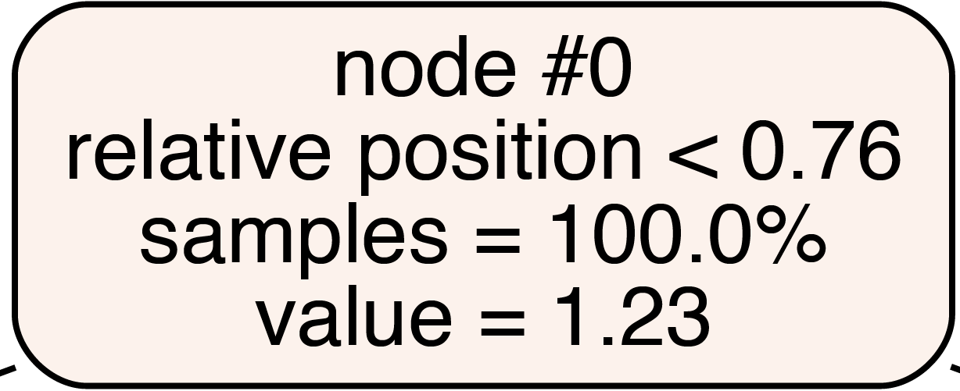
Regression Trees
 | MAE | Important features
RT without name of the tasks | 0.473 | relative position, number of predecessors, planned duration
RT with name of the tasks | 0.375 | relative position, task names, number of predecessors, planned duration
task names
Insight: Task names is an important factor only when the task is at the first 75% of the project timeline.

Slide 31
Future work
Further contextualize the tasks by incorporating predecessors and successors’ text information using graph models
Scale up the numeric evaluation using the 250,000 construction projects
Predict distributions of task delays and project delays

